Slide 1
CI453
Ben Highgate, Ahmed El-Hawat, Michael Ugwumba, Minas Fakhori

Slide 2
Agenda
The website
Project management
Group Communication
Legal & ethical considerations

Slide 3
The Website
Subtitle

Slide 4
Project Management
Research
· Brainstorming
·Target audience research
· Designing of the website
1
Planning
· Delegation of tasks.
· Time management(gantt chart)
· To do list Trello
2
Development
· HTML
· CSS
· JS
3
Combining the websites and testing
· Github
· HTML validation
· CSS validation
· Black box test
4

Slide 5
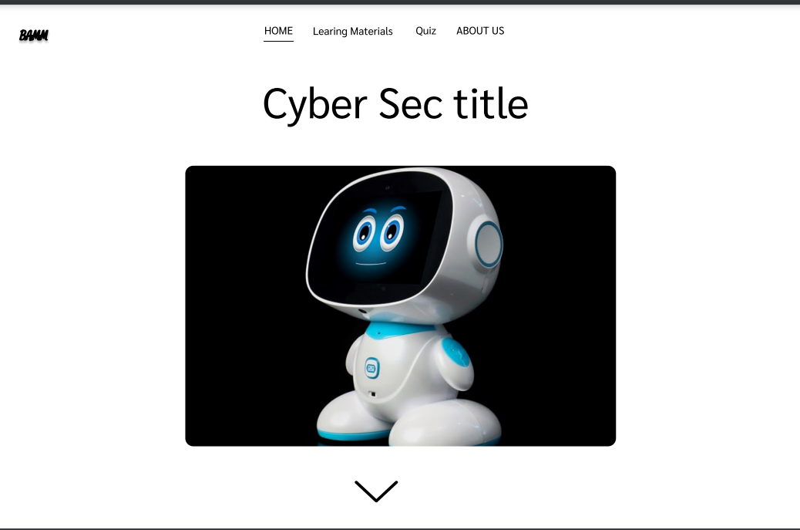
Research
1
Research
· Target audience research
· Brainstorming
· Designing of the website

Slide 6
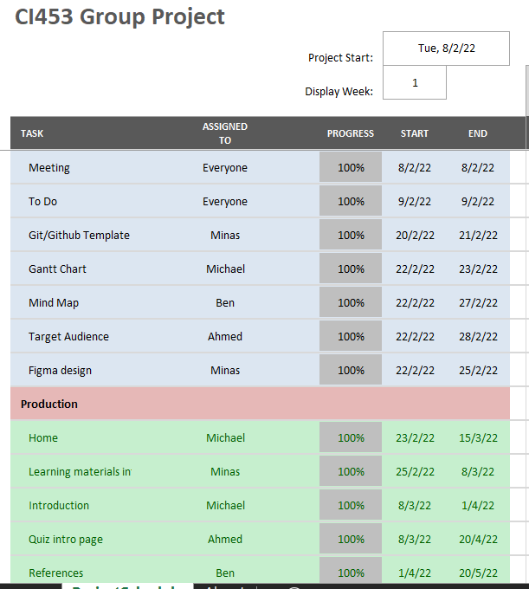
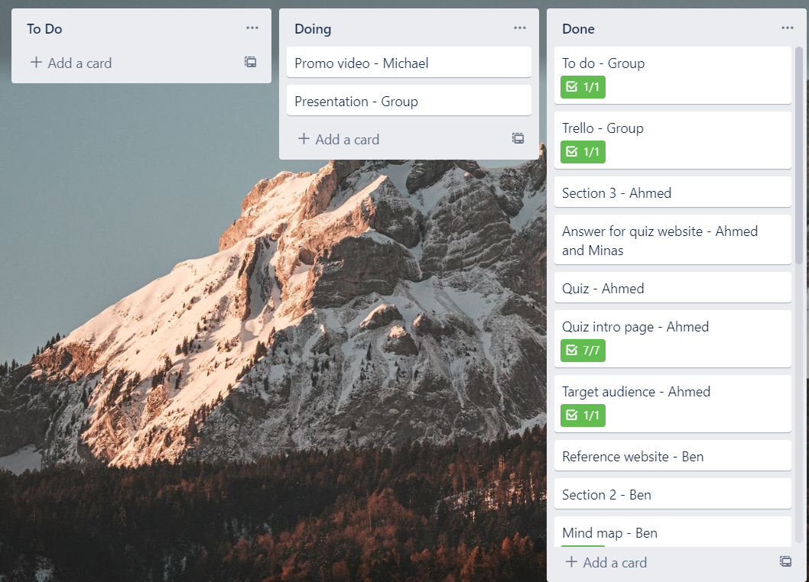
Planning
2
Planning
· Delegation of tasks.
· Time management(gantt chart)
· To do list Trello

Slide 7
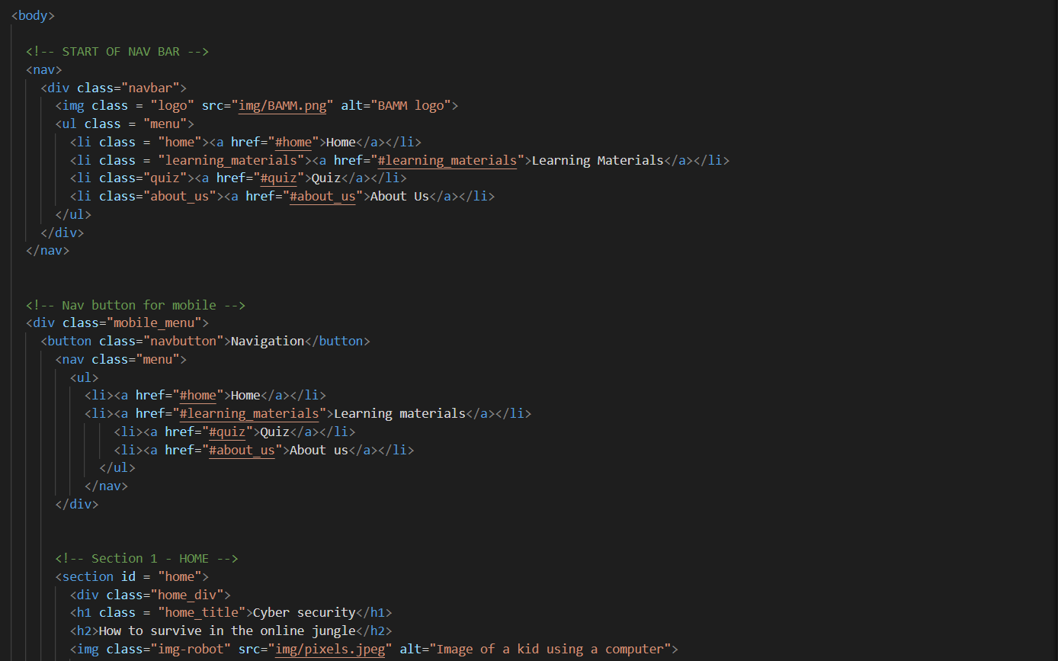
Development
3
Development
· HTML
· CSS
· JS

Slide 8
Our website
Features
Interactive quiz
Navigation
Page previews
Accessibility features
***The contact page (best)
Responsive

Slide 9
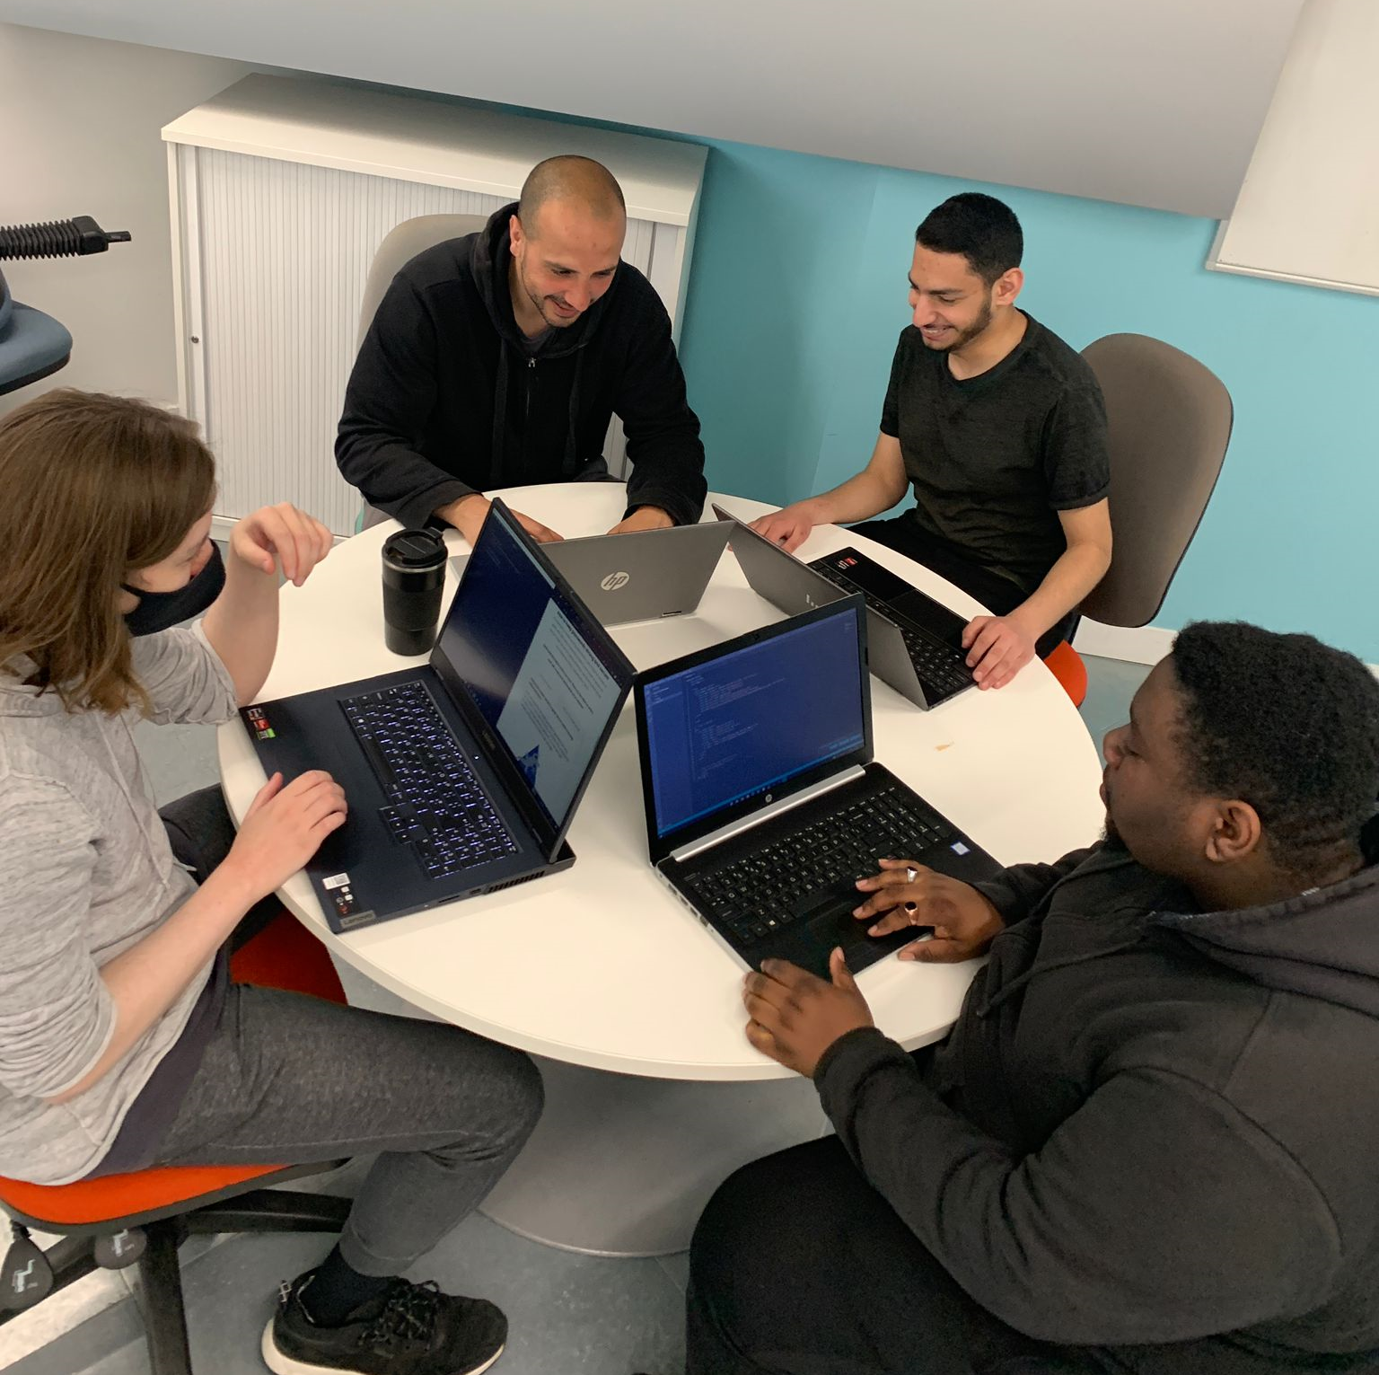
Working as a team and Group communication

Slide 11
Legal & ethical considerations

Slide 12


Summary
With PowerPoint, you can create presentations and share your work with others, wherever they are. Type the text you want here to get started. You can also add images, art, and videos on this template. Save to OneDrive and access your presentations from your computer, tablet, or phone.

Slide 13
Thank you
Presenter name
Email address
Website

